Slide 1
Unit 4
Assembly Level Programming

Slide 2
What is Assembly Language?
An assembly (or assembler) language, often abbreviated asm, is a low-level programming language for a computer, or other programmable device, in which there is a very strong (generally one-to-one) correspondence between the language and the architecture's machine code instructions.
Assembly language is converted into executable machine code by a utility program referred to as an assembler. The conversion process is referred to as assembly, or assembling the source code. Assembly time is the computational step where an assembler is run.
Assembly language uses a mnemonic to represent each low-level machine instruction or opcode, typically also each architectural register, flag, etc. Many operations require one or more operands in order to form a complete instruction and most assemblers can take expressions of numbers and named constants as well as registers and labels as operands, freeing the programmer from tedious repetitive calculations.

Slide 3
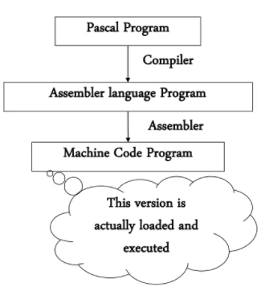
What is Assembly Language?
Assembler An assembler is a program that takes basic computer instructions and converts them into a pattern of bits that the computer's processor can use to perform its basic operations. Some people call these instructions assembler language and others use the term assembly language.
Assembly language is an intermediate step between high level language and machine code.
Sometimes high level language such as pascal programs are sometimes converted firstly to assembly langauge by a computer program called compiler and then into machine code by another program called assembler.

Slide 4
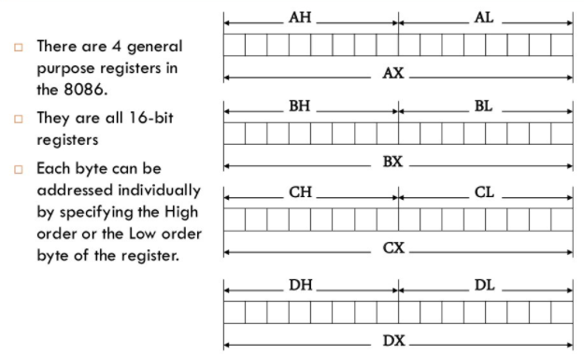
What is Assembly Language?

Slide 5
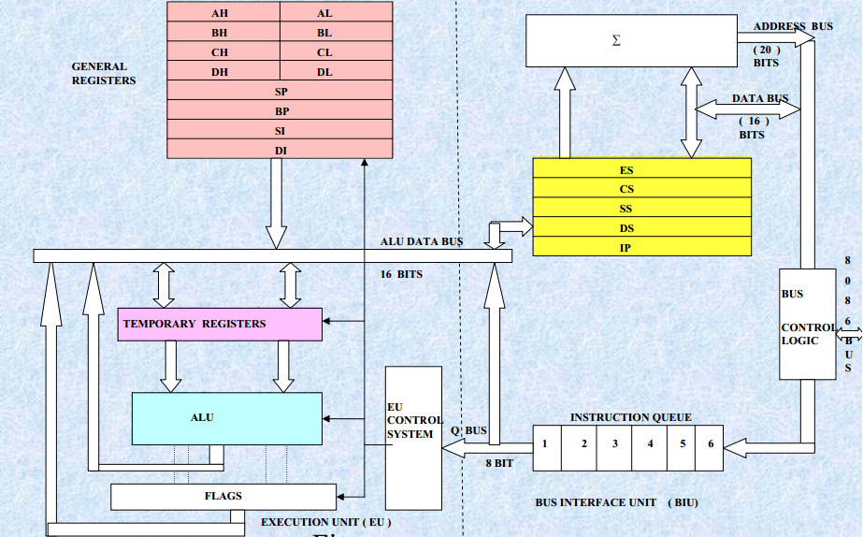
8086 microprocess :Architecture

Slide 6
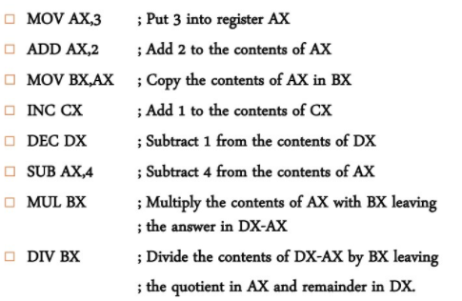
Some simple commands in

Slide 7
Register
A CPU contain a number of register to store data temporarily during the execution of a program.
Registers are essentially extremely fast memory locations within the CPU that are used to create and store the results of CPU operations and other calculations. Different computers have different register sets. They differ in the number of registers, register types, and the length of each register. They also differ in the usage of each register.
Register is simply a collection of flip flops that can be used to store a binary number. There must be one flip flop for each bit in the binary number. So n-bit register is built of n ﬂip- ﬂops. For example, a register used to store 8 bit binary number must have 8 flip flop.
The operations executed on data stored in registers are called microoperations. A microoperation is an elementary operation performed on the information stored in one or more registers. The result of the operation may replace the previous binary information of a register or may be transferred to another register. The number of registers differs from processor to processor.

Slide 8
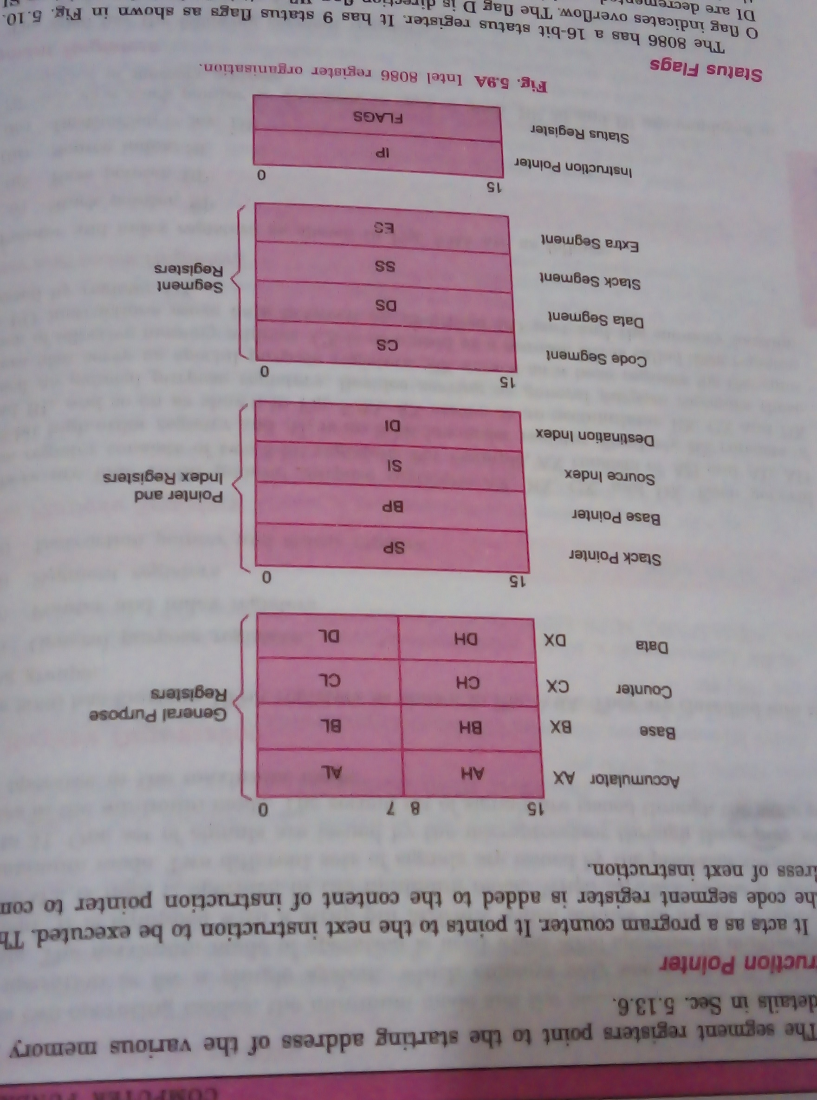

Slide 9
Classification of register (Based on 8086 microprocessor)
General purpose register
General-purpose registers can be used for multiple purposes and assigned to a variety of functions by the programmer. It is user visible register. In 8086 microprocessor. The registers AX, BX, CX, and DX are the general 16-bit registers.
AX Register: Accumulator register consists of two 8-bit registers AL and AH, which can be combined together and used as a 16- bit register AX. AL in this case contains the low-order byte of the word, and AH contains the high-order byte. Accumulator can be used for I/O operations, rotate and string manipulation. It is most efficient in data movement, arithmetic and logical operation. Its function depends on the design of the processor whether the processor is an accumulator based processor or general purpose registers based processor. After the execution of arithmetic and logical instruction the result is placed in the accumulator. All data transfer between CPU and device/port are performed through the accumulator.

Slide 10
Classification of register (Based on 8086 microprocessor)
General purpose register
BX Register: This register is mainly used as a base register. It holds the starting base location of a memory region within a data segment. It is used as offset storage for forming physical address in case of certain addressing mode.
CX Register: It is used as default counter or count register in case of string and loop instructions.
DX Register: Data register can be used as a port number in I/O operations and implicit operand or destination in case of few instructions. Some I/O instruction move data between and identified I/O port and the memory location address by register DX.

Slide 11
Classification of register (Based on 8086 microprocessor)
Pointer and index register
Stack pointer (SP): The stack is a sequence of memory location defined by the user. It is used to save the contents of a register if it is required during the execution of a program. The stack pointer holds the address of the last occupied memory location of the stack. Thus indicates upto what memory location the stack is already filled up.The PUSH instruction is used to transfer the content of the register to the stack and the POP instruction to bring back content from the stack to the register.
Base Pointer (BP): Its helps in referencing the parameter variables passed to a subroutine. The address in SS register is combined with the offset in BP to get the location of the parameter. BP can also be combined with DI and SI as base register for special addressing.
Source Index (SI): It is used as source index for string operation.
Destination Index (DI): It is used as a destination index for string operation.

Slide 12
Classification of register (Based on 8086 microprocessor)
Segment register: A segment register points to the starting address of the particular memory segment. Types of segment register:
Code segment: It contains all the instructions to be executed. The instruction codes resides on the code segments. It points to the starting address of the code segment.
Data segment: local data variables and constant resides in the data segments. It indicates the starting address of the data segment.
Stack segment: The stack segment register stores the starting address of the stack.
Extra segment: External(global) data reside in extra segment.

Slide 13
Classification of register (Based on 8086 microprocessor)
Special purpose register
CPU contains a number of special purpose registers for different purposes.
Instruction Pointer: It act as a program counter used to point to the next instruction to be executed. So, it holds the address of the memory location which contains the next instruction to be fetched from the memory. Its content is automatically incremented after an instruction has been fetched assuming that instructions are normally executed sequentially. In case of a jump instruction its contents are modified and program jump to the memory location which contains the desired instruction to be executed next. The processor which use data flow architecture do not contain PC. The content of code segment register is added to the content of the IP to compute the address of the next instruction.

Slide 14
Classification of register (Based on 8086 microprocessor)
Special purpose register
Stack pointer: The stack is a sequence of memory location defined by the user. It is used to save the contents of a register if it is required during the execution of a program. The stack pointer holds the address of the last occupied memory location of the stack. Thus indicates upto what memory location the stack is already filled up.

Slide 15
Classification of register (Based on 8086 microprocessor)
Status Flag: The 8086 has 16 bit status register. It has 9 status flags.
8086 microprocessor contains the following control flags:
Directional flag(D): This is used in string related operation. If D=1, then the string will be accessed from higher memory address to lower memory address, and if D=0, it will do the reverse i.e. When it is 1 index register SI and DI are decremented resulting in the access of string from the highest memory address down the lowest memory address. If the direction status is 0, the index register SI and DI are incremented resulting in the access of strings from the lowest memory address.
Interrupt flag (I): If I=1, then MPU will recognize the interrupt from pheripherals. If I=0, the interrupt will be ignored.
Trap flag(T): It is used for on chip debugging. When T=1, the CPU automatically generates an internal interrupt after each instruction, allowing a program to be inspected as it executes instruction by instruction. If trap is reset to 0 no function is performed.

Slide 16
Classification of register (Based on 8086 microprocessor)
8086 microprocessor contains the following condition flags:
Carry flag (CY): It indicates whether there is carry or not after an arithmetic or logical operation. If some operations are generating carry after the operation this flag is set 1.
Zero flag(Z): It indicate whether the result of arithmetic or logical operation is zero or non-zero.
Sign flag(S): It indicate whether the result is –ve or +ve.
Parity flag(P): It indicate whether the result contains odd number of 1’s or even number of 1’s.
Axuillary carry(AC): It is also known as half carry. When some arithmetic operation generates carry after the lower half and send it to upper half the AC will be 1.
Overflow Flag (O): The overflow flag is set to 1 when the result of signed operation is too large to fit in the number bits available to represent it.

Slide 17
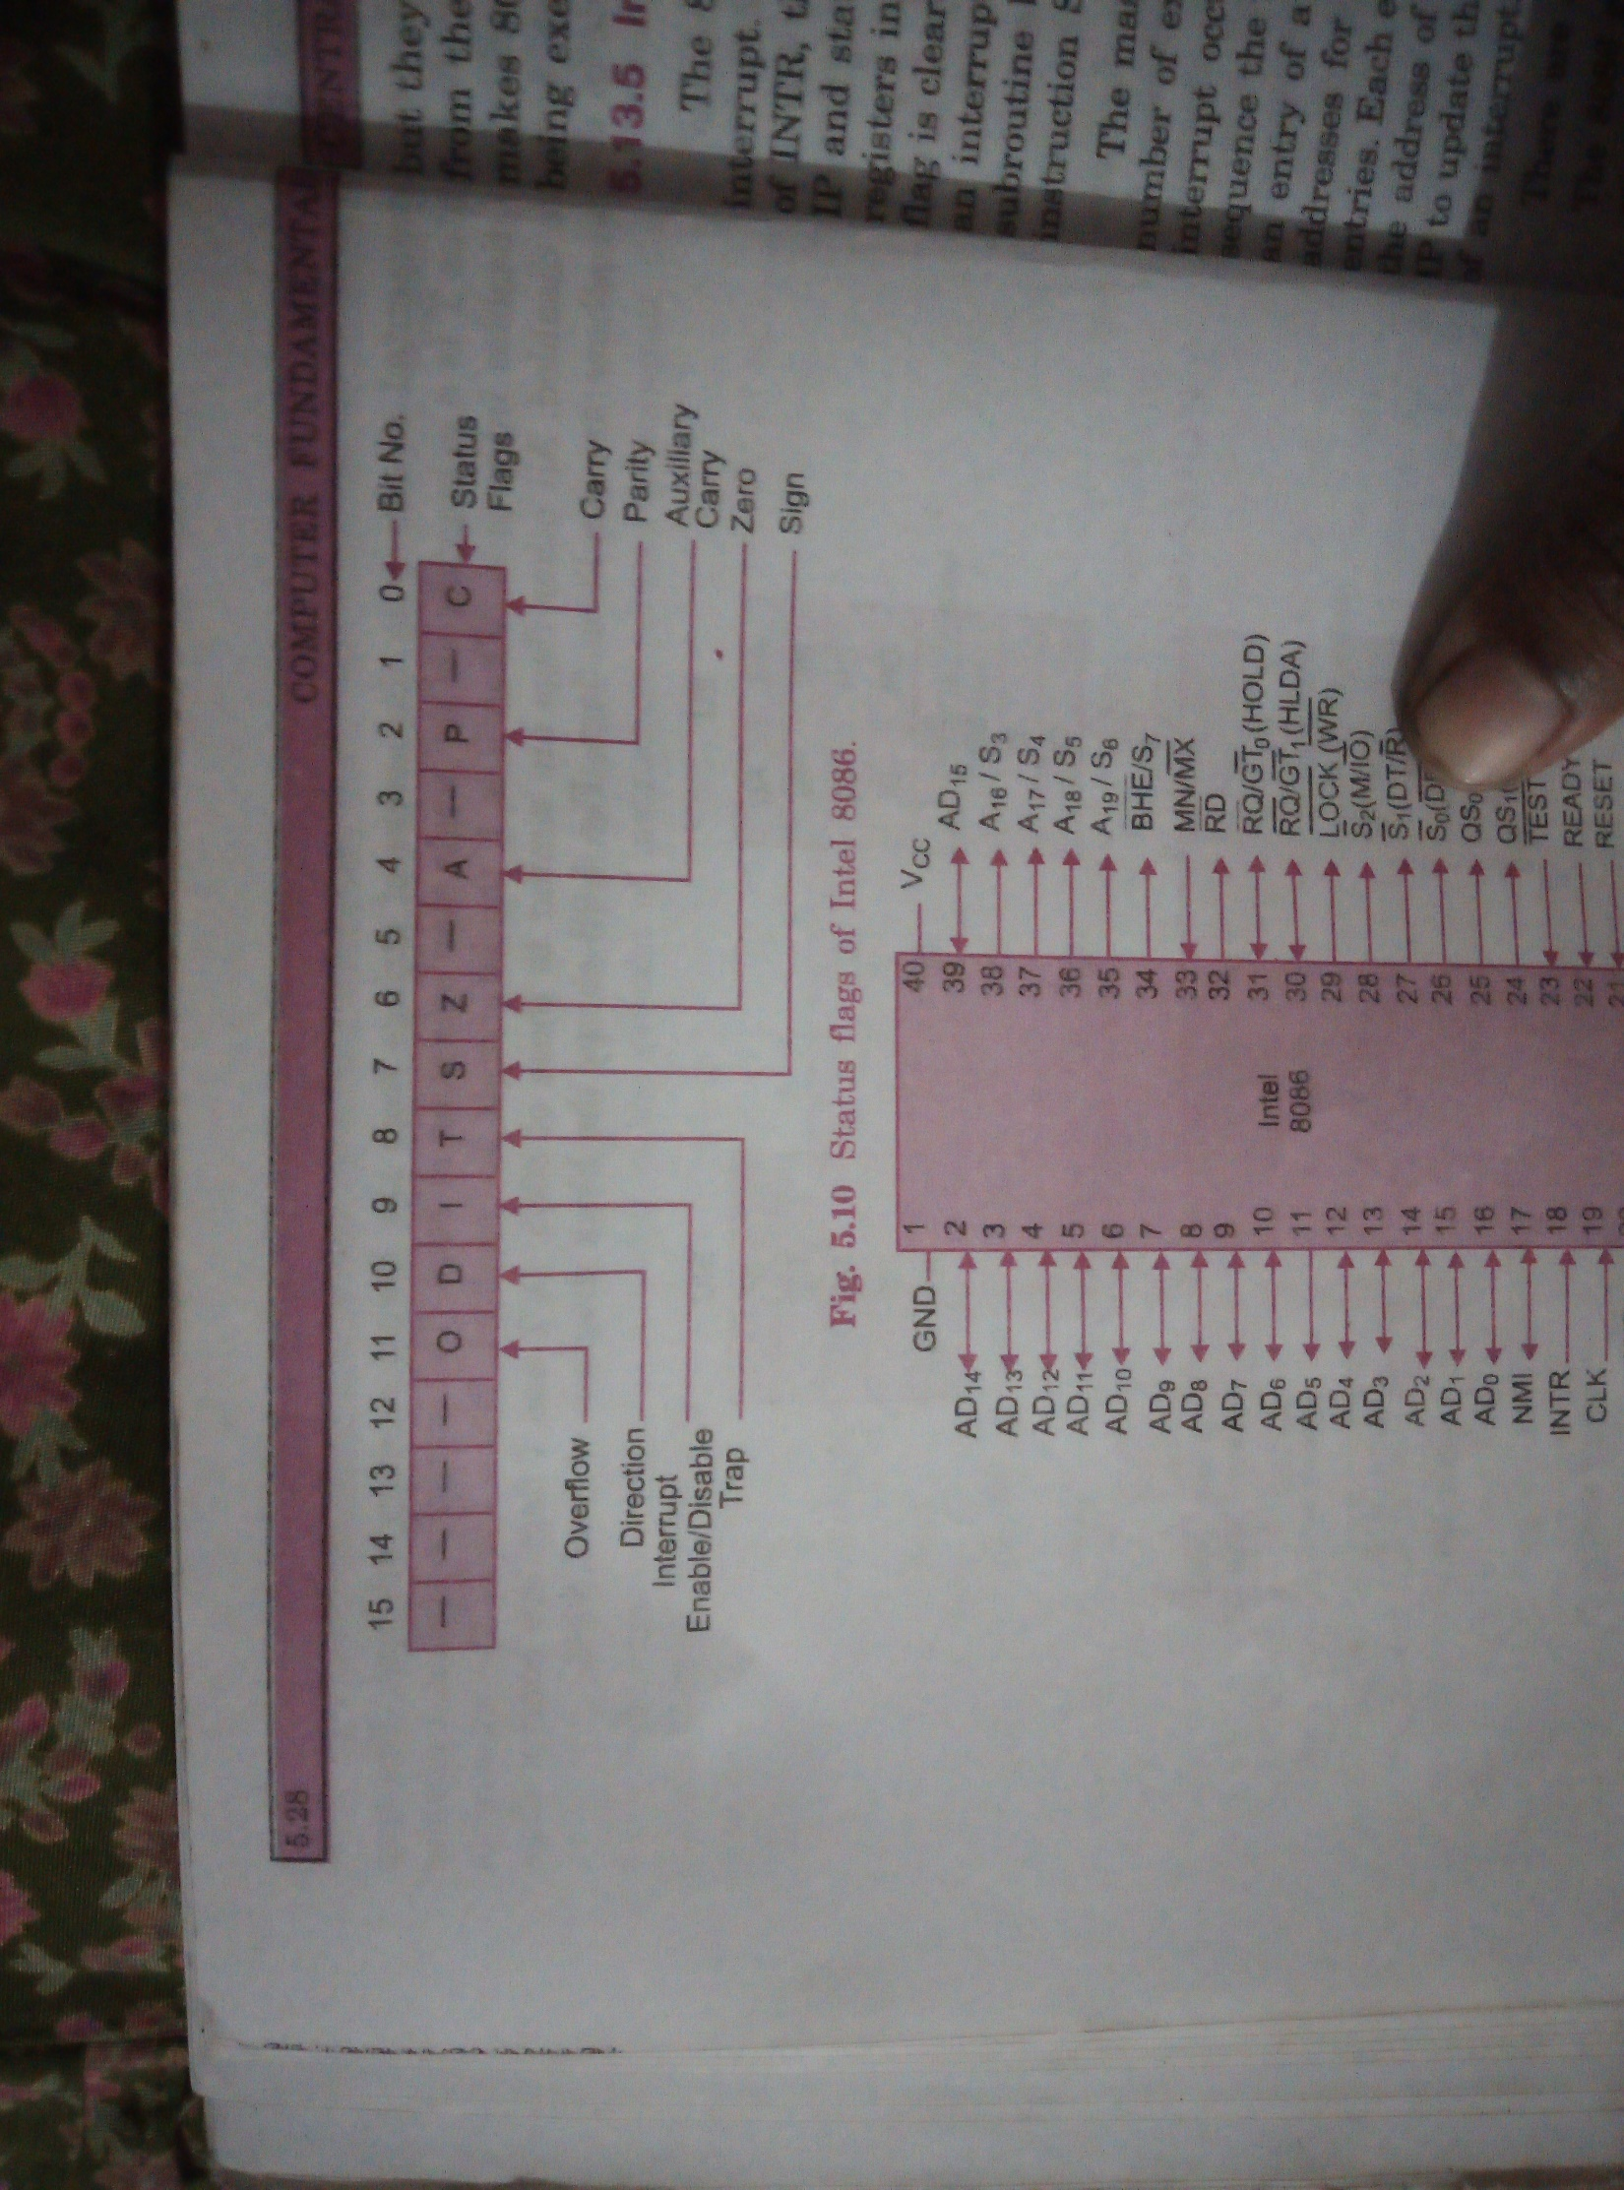
Classification of register (Based on 8086 microprocessor)

Slide 18
8086 Instruction sets
An instruction is a binary pattern designed inside a microprocessor to perform a specific function.
The entire group of instruction that a microprocessor supports is called instruction set. 8086has more than 20000 instructions.
We can categorize instruction sets into following types:
Data transfer instructions
Arithmetic instructions
Bit manipulation instructions
Program execution transfer instructions
String instructions
Process control instructions.

Slide 19
8086 Instruction sets: Data transfer instructions
These instructions are used to transfer data from source to destination.
The operand can be a constant, memory location, register or I/O port address.
We can transfer data from one register to another, register to memory, memory to register but transferring data from memory to memory is illegal.
Some of the instructions used for data transfer are: mov, push, pop, xchg, in, lea, lds, etc.
MOV Des, Src:
Src operand can be register, memory location or immediate operand whereas Des can be register or memory operand. Both Src and Des cannot be memory location at the same time.
MOV CX, 037AH
MOV AL, BL
MOV BX, [0301h]

Slide 20
8086 Instruction sets: Data transfer instructions
PUSH and POP:
PUSH help to move operand into top of stack
POP helps to remove the operand from top of stack and place it in Des. Des can be general purpose register, segment register or memory location.
Example: PUSH BX
POP AX
XCHG:
This instruction exchanges Src with Des. It cannot be possible to exchange two memory locations directly.
Example: XCHG DX, AX
IN
It transfer the oprand from specified port to accumulator register.
Example: IN AX, 0028H
Out
It transfer the operand from accumulator to specified port.

Slide 21
8086 Instruction sets: Data transfer instructions
LEA
It loads a16 bit register with the offset address of the data specified by the src.
Example: LEA BX, [DI]
This instruction loads the contents of DI (offset) into BX register.

Slide 22
8086 Instruction sets: Arithmetic Instructions
ADD
It adds a byte to byte or word to word. It effects AF, CF, OF, PF, SF, ZF flags.
Add AL, 74H
ADD DX, AX
ADD AX, [BX]
ADC
It adds two operands with CF. It effects AF, CF, OF, PF, SF, ZF flags.
ADC AL, 74h
ADC DX, AX
ADC AX, [BX]
SUB
It subtracts a byte from byte or word from word. It effects AF, CF, OF, PF, SF, ZF flags. For subtraction CF, acts as borrow flag.

Slide 23
8086 Instruction sets: Arithmetic Instructions
INC
It increments the byte or word by one. The operand can be a register or memory location.
It effects AF, OF, PF, SF, ZF flags. CF cannot be affected.
DEC
It decrements the byte or word by one. The operand can be a register or memory location.
It effects AF, OF, PF, SF, ZF flags. CF cannot be affected.
AAA (ASCII Adjust After Addition)
The data entered from terminal is in ASCII format. In ASCII 0-9 are represented by 30H-39H. This instruction allows us to add the ASCII codes. This instruction doesnot have any operand.
Other ASCII instructions are: AAS (ASCII adjust after subtraction), AAM (ASCII adjust after multiplication), AAD (ASCII adjust before devision).

Slide 24
8086 Instruction sets: Arithmetic Instructions
NEG :
IT creates 2’s complement of a given number. That means it changes the sign of a number.
CMP
It compares two specified bytes or words. The src and des can be a constant, register or memory location. Both operands cannot be memory location. The comparison is done simply by internally subtracting the source from destination. The value of source and destination doesnot change but the flags are modified to indicate the result.
MUL
It is an unsigned multiplication instruction. It multiplies two bytes to produce a word or two words to produce a double word. IMUL is a signed multiplication instruction.

Slide 25
8086 Instruction sets: Arithmetic Instructions
DIV
It is an unsigned division instruction. It divides word by byte or double word by word. The operand is stored in AX. The result is stored as:
AH=remainder AL=Quotient
IDIV is a signed division instruction.
CBW
This instruction converts bytes in AL to word in AX. This conversion is done by extending the sign bit of AL through out AH.

Slide 26
8086 Instruction sets: Bit manipulation
These instructions are used at bit level. These instructions are used for shifting bits, testing a zero bit or changing a bit value. Instructions used for bit manipulation are: NOT, AND, OR, XOR, SHL, ROL, ROR, etc.
NOT
It complements each bit of Src to produce 1’s complement of specified operand. The operand can be a register or memory location.
AND
It performs AND operation of Des and Src.
Src can be immediate number, register or memory location. Des can be register or memory location.
Both operands cannot be memory location at the same time. CF and OF become zero after the operation. PF, SF, ZF are updated.

Slide 27
8086 Instruction sets: Bit manipulation
OR
It performss OR operation of Des and Src. Src can be immediate number, register or memory location. Des can be register or memory location. Both operands cannot be memory locations at the same time. CF and OF becomes zero after the operation whereas PF, SF, ZF are updated.
XOR
It performs XOR operation of Des and Src. Src can be immediate number, register or memory location. Des can be register or memory location. Both operands cannot be memory locations at the same time. CF and OF becomes zero after the operation whereas PF, SF, ZF are updated.
SHL
It shift bits of byte or word left by count. It puts zero(s) in LSBs, MSB is shifted into carry flag. If the number of bits desired to be shifted is 1 then immediate number 1 can be written in Count. But if the number of bits to be shifted is more than 1 then count is put in CL register.
Example: shl bx, 5

Slide 28
8086 Instruction sets: Bit manipulation
SHR
It shift bits of byte or word right by count. It puts zero(s) in MSB, LSB is shifted into carry flag. If the number of bits desired to be shifted is 1 then immediate number 1 can be written in Count. But if the number of bits to be shifted is more than 1 then count is put in CL register.
Example: sh bx, 5
SAR
It stands for Shift Arithmetic Right. It shifts the mentioned bits in registered in to right side one by one but instead of inserting zeros from left end, MSB is restored. The rightmost bit that is being shifted is stored in carry flag (CF).
SAL
It stands for Shfit Arithmetic Left. It shifts the mentioned bits in registered into left side one by one.
Other bit manipulation instructions are: ROR,, ROL, RCL, RCR, etc

Slide 29
8086 Instruction sets: Program Execution Transfer Instructions
These instructions cause changein sequence of the execution of instruction. This change can be through a condition or sometimes unconditional. The conditions are represented by flags. Some of the program execution instructions are call, ret, jmp, ja, jae, je, jnc, jne, jnz, jpe, jz, etc.
Call
This instruction is used to call a subroutine or function or procedure. The address of next instruction after call is saved into stack.
Ret
It returns the control from procedure to calling program. Every call instructions should have a RET.
JMP
This instruction is used for unconditional jump from one place to another.

Slide 30
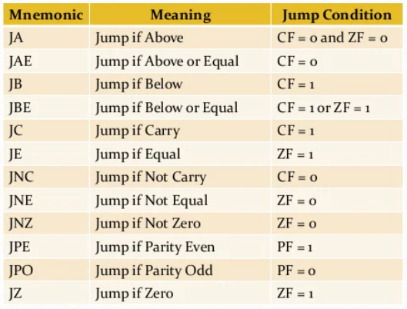
8086 Instruction sets: Program Execution Transfer Instructions
Jxx (conditional jump)
All the conditional jumps follows some conditional statement or any instruction that affects the flag.

Slide 31
8086 Instruction sets: Program Execution Transfer Instructions
Loop
This is a looping instruction. The number of times looping is required is placed in the CX register. With each iteration, the content of CX are incremented. ZF is checked whether to loop again or not.

Slide 32
8086 Instruction sets: String instructions
String in assembly language is just a sequentially stored bytes or words.
There are very strong set of string instructions in 8086 by the use of which the size of program is considerably reduced. Some of the instructions are : cmps, scas, movs, movsb, movsw, rep, etc.

